Slide 1
OBSERVABILITY DEEP DIVE
Dynatrace
Architecture, Data Collection & End-to-End Observability
Presented by:
Prem Kumar Vula - Site Reliability Engineer
03 August 2026
1

Slide 2
SESSION ROADMAP
Agenda for Today
01
What is Dynatrace?
02
Monitoring vs Observability
Why full-stack observability matters
The core mindset shift
03
Dynatrace Architecture Deep Dive
04
How OneAgent Collects Data
OneAgent, ActiveGate, SaaS, Davis AI
OneAgent runs as a DaemonSet
05
Data Collection Flow
06
Live Architecture Demo
Metrics, logs & traces end-to-end
Dashboards SLI & SLO
Dynatrace KT Session
2

Slide 3
THE BASICS
What is Dynatrace?
An all-in-one Observability Platform that monitors applications, servers, Kubernetes clusters, cloud services, databases, and real user experience — from a single pane of glass.
500+
Is my application healthy?
servers, hundreds of apps —
one unified dashboard
Is the database responding properly?
Which service is causing the issue?
Without Dynatrace, engineers manually log into servers, pull logs, and check CPU / memory / network one by one — costing hours during an outage.
Are users facing errors right now?
Dynatrace automates this — pinpointing the app, server, database, and root cause automatically.
Dynatrace KT Session
3

Slide 4
CORE CONCEPT
Monitoring vs Observability
M
Monitoring
O
Observability
Tells us SOMETHING is wrong
Tells us WHY it is wrong
CPU > 80% → Alert
Metrics — what is happening
Memory > 90% → Alert
Logs — what exactly happened
Disk > 85% → Alert
Traces — the full request path
Simple threshold-based checks
Combined → automatic root cause
“CPU looks normal, memory looks normal... but users still complain.”
“Authentication service waiting 6 seconds for the database — that's the root cause.”
Dynatrace KT Session
4

Slide 5
FOUNDATION
The Three Pillars of Observability
M
L
T
METRICS
LOGS
TRACES
What is happening
What exactly happened
Where it happened
Numeric values over time — CPU, memory, disk, response time, request count, error rate.
Detailed event records — connection failures, exceptions, authentication errors, timeouts.
Follows a single request end-to-end: Load Balancer → App → Auth → Database → Response.
Dynatrace KT Session
5

Slide 6
HOW IT'S BUILT
Dynatrace Architecture Overview
Your Infrastructure
Hosts, containers, pods, processes, services
OneAgent
One agent per host — auto-discovers everything, collects metrics/logs/traces
ActiveGate
HTTPS : 443
Secure gateway — routes, filters & optionally caches data (optional layer)
Dynatrace SaaS
Central platform that stores and processes all telemetry
Davis AI
Correlates data automatically → root cause, dashboards, alerts
Dynatrace KT Session
6

Slide 7
COMPONENT 01
OneAgent — The Data Collector
A single agent installed on every host, VM, or Kubernetes node. It auto-discovers everything running on that machine — no manual instrumentation, no code changes.
Worker Node
OneAgent (DaemonSet)
✓
Auto-discovery
Pods, containers, services, processes & nodes detected automatically
Pod A
✓
Full-stack visibility
Pod B
Infrastructure, application, and user-experience layers in one agent
Zero code changes
Pod C
✓
No SDK, no manual tracing calls — instrumentation is automatic
OneAgent watches every pod on this node and reports up automatically.
✓
Continuous collection
Metrics, logs, and distributed traces streamed in real time
Dynatrace KT Session
7

Slide 8
COMPONENTS 02 & 03
ActiveGate & Davis AI
A
ActiveGate
D
Davis AI
The secure routing layer (optional)
The AI causation engine
Sits between OneAgent and Dynatrace SaaS
Correlates metrics, logs & traces automatically
Handles secure outbound HTTPS traffic
Distinguishes root cause from downstream symptoms
Enables monitoring of environments without direct internet access
Generates Problem Cards with the exact culprit
Used for cloud, extension & synthetic monitoring too
Reduces Mean Time To Resolution (MTTR)
Dynatrace KT Session
8

Slide 9
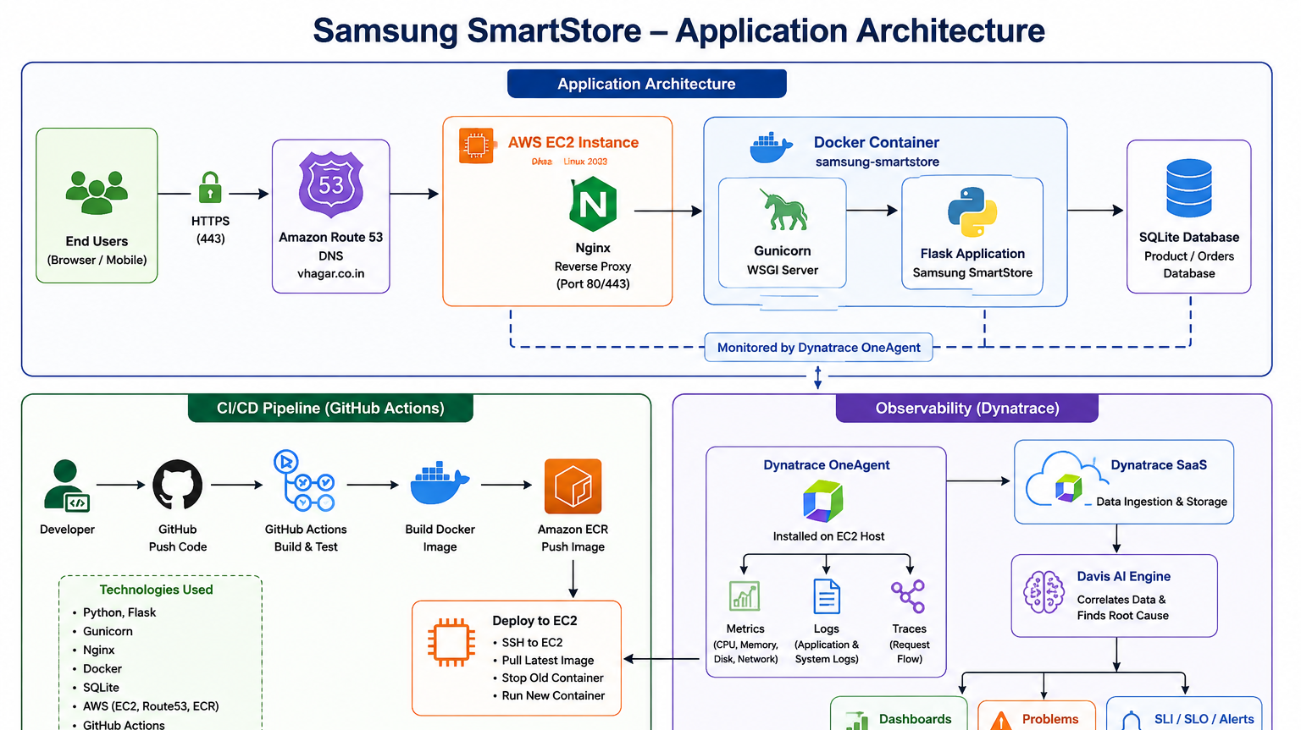

Slide 10
PART 1 · WHAT WE'RE MONITORING
Samsung SmartStore — Application Architecture
Internet / Users
Route53 DNS
Nginx (reverse proxy, static files)
Gunicorn (WSGI workers)
Flask App — Samsung SmartStore
SQLite Database
Docker Container
AWS EC2 (Amazon Linux 2023)
Every one of these layers is where OneAgent quietly attaches and starts collecting telemetry — no code changes required.
Part 1 — Application Architecture (5 min)
Samsung SmartStore · Dynatrace KT

Slide 11
PART 2 · DYNATRACE ARCHITECTURE
OneAgent → ActiveGate → SaaS → Davis AI
Users
Real traffic hitting the app
Application (EC2 / Docker)
Nginx, Gunicorn, Flask, SQLite
OneAgent
Installed on the host — auto-discovers processes, collects metrics/logs/traces
ActiveGate (optional)
Secure gateway for private/enterprise networks
Dynatrace SaaS
Stores & processes all telemetry
Davis AI
Correlates everything, finds root cause automatically
Dashboards · Problems · Alerts
What the SRE actually sees
Part 2 — Dynatrace Architecture (8 min)
Samsung SmartStore · Dynatrace KT

Slide 12
THE MASTER NARRATIVE
The One Flow That Explains Everything
01
02
03
User opens the website
Request reaches EC2 / Docker container
Flask app processes it → queries SQLite
04
05
06
OneAgent captures metrics, logs & traces
Data sent to Dynatrace SaaS
Davis AI correlates the telemetry
07
08
09
Dashboards update in real time
A problem is detected
SLO is evaluated against target
10
11
12
Alert is generated
Engineer opens the trace → finds root cause
Issue is resolved — MTTR reduced
This single thread is used to introduce every concept in the demo that follows
Samsung SmartStore · Dynatrace KT

Slide 13
STEP BY STEP
How Data Actually Flows
1
2
3
User Request
OneAgent Captures
ActiveGate Routes
A user opens the app; a request enters the system
Metrics, logs & traces are captured at the host/pod level
Data is securely forwarded (optional hop)
4
5
6
Dynatrace SaaS
Davis AI Correlates
Dashboards & Alerts
Telemetry is centrally stored and processed
Root cause is identified automatically
Teams get answers, not just data
Dynatrace KT Session
10

Slide 14
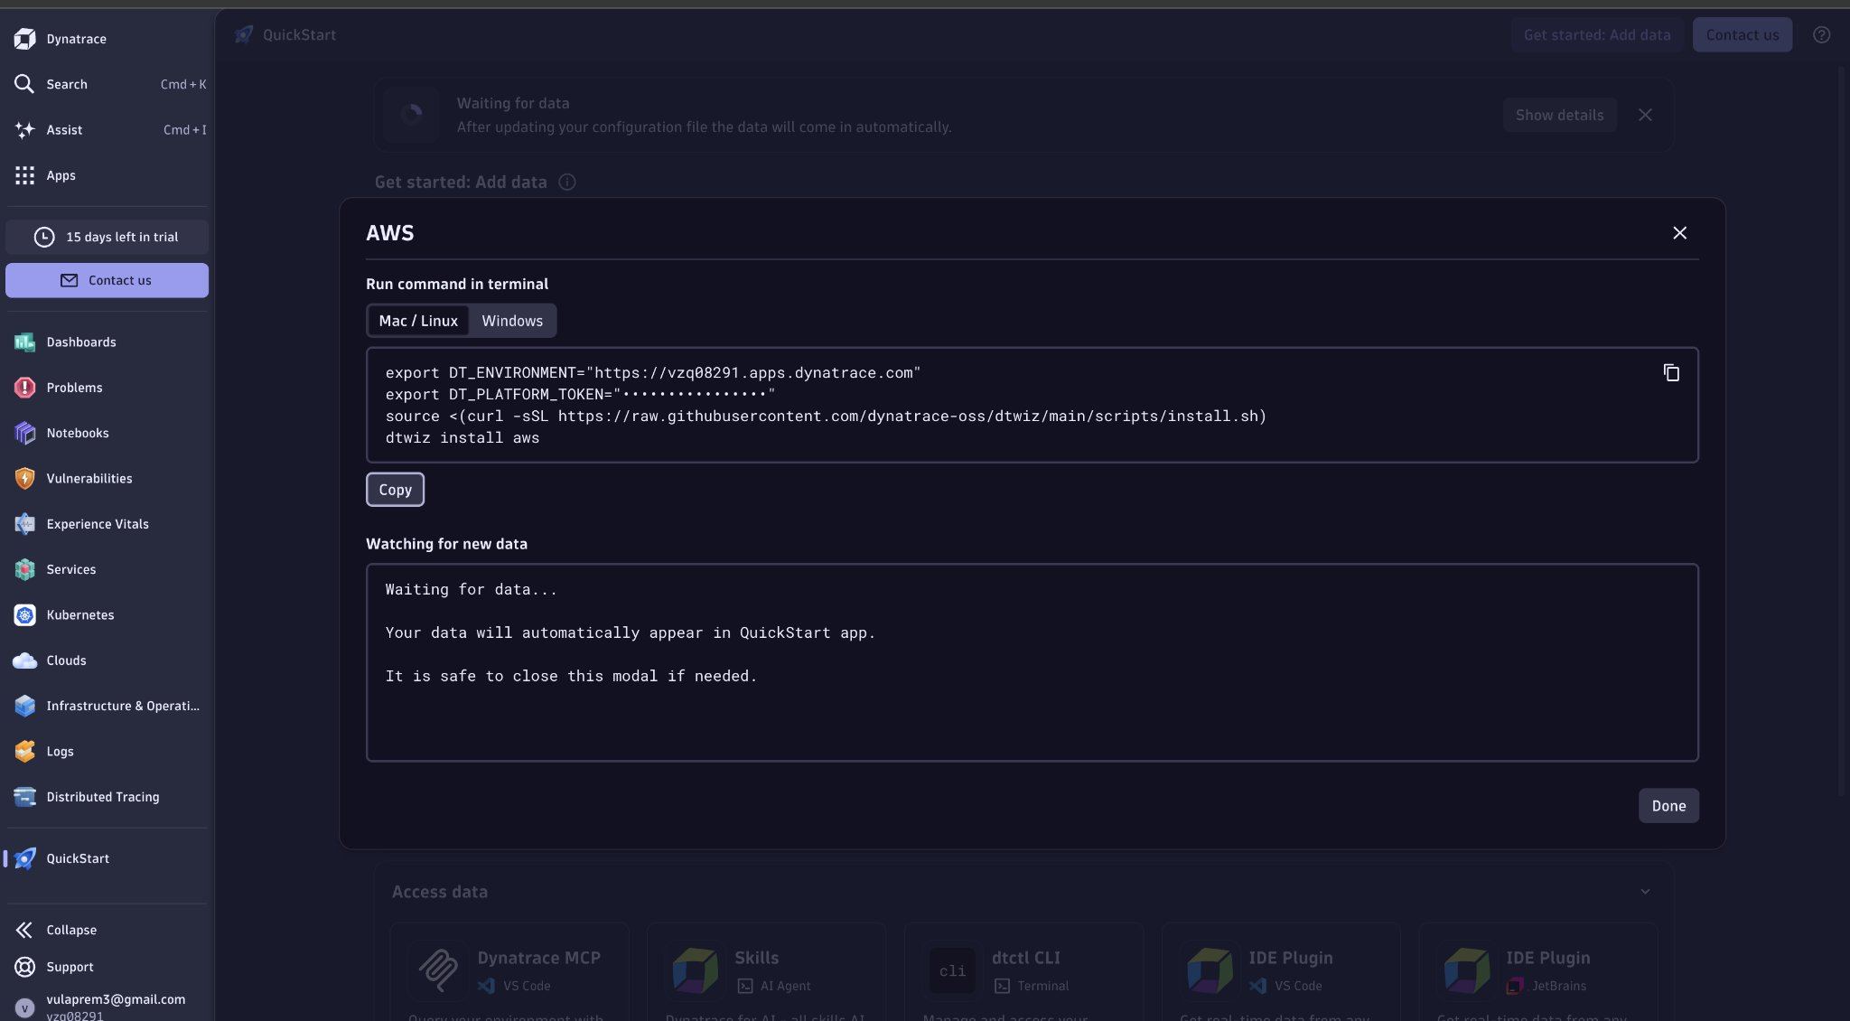
LIVE DEMO
1 — OneAgent & AWS Integration
We connect Dynatrace to our AWS account and install OneAgent on the EC2 host.
The dtwiz installer script pulls the correct OneAgent build for the platform automatically.
No manual instrumentation of Flask code — OneAgent injects itself at the process level.
Within minutes, host, process, and AWS resource data starts flowing in.
Live Demo: Setup (5 min)
Samsung SmartStore · Dynatrace KT

Slide 15
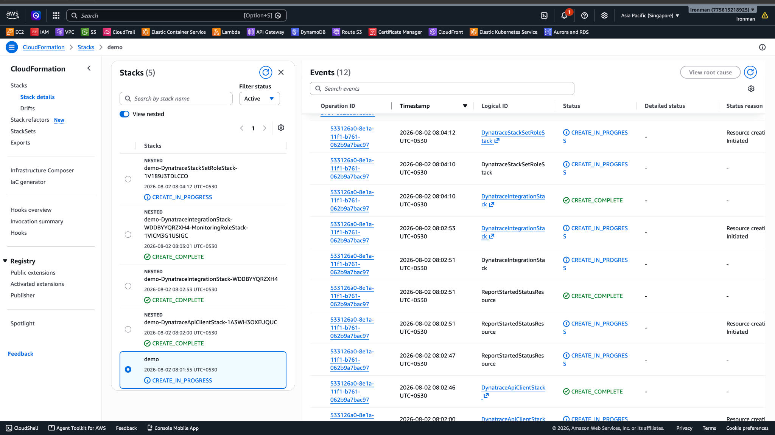
LIVE DEMO
Demo 2 — Infrastructure as Code Deployment
Dynatrace's AWS integration deploys via a CloudFormation stack — repeatable and auditable.
It provisions the IAM roles and monitoring configuration needed to read AWS metrics.
This is the same pattern our GitHub Actions pipeline follows for the app itself.
Once complete, AWS services appear automatically in the Dynatrace Clouds view.
Part 5 — Live Demo: AWS Integration (5 min)
Samsung SmartStore · Dynatrace KT

Slide 16
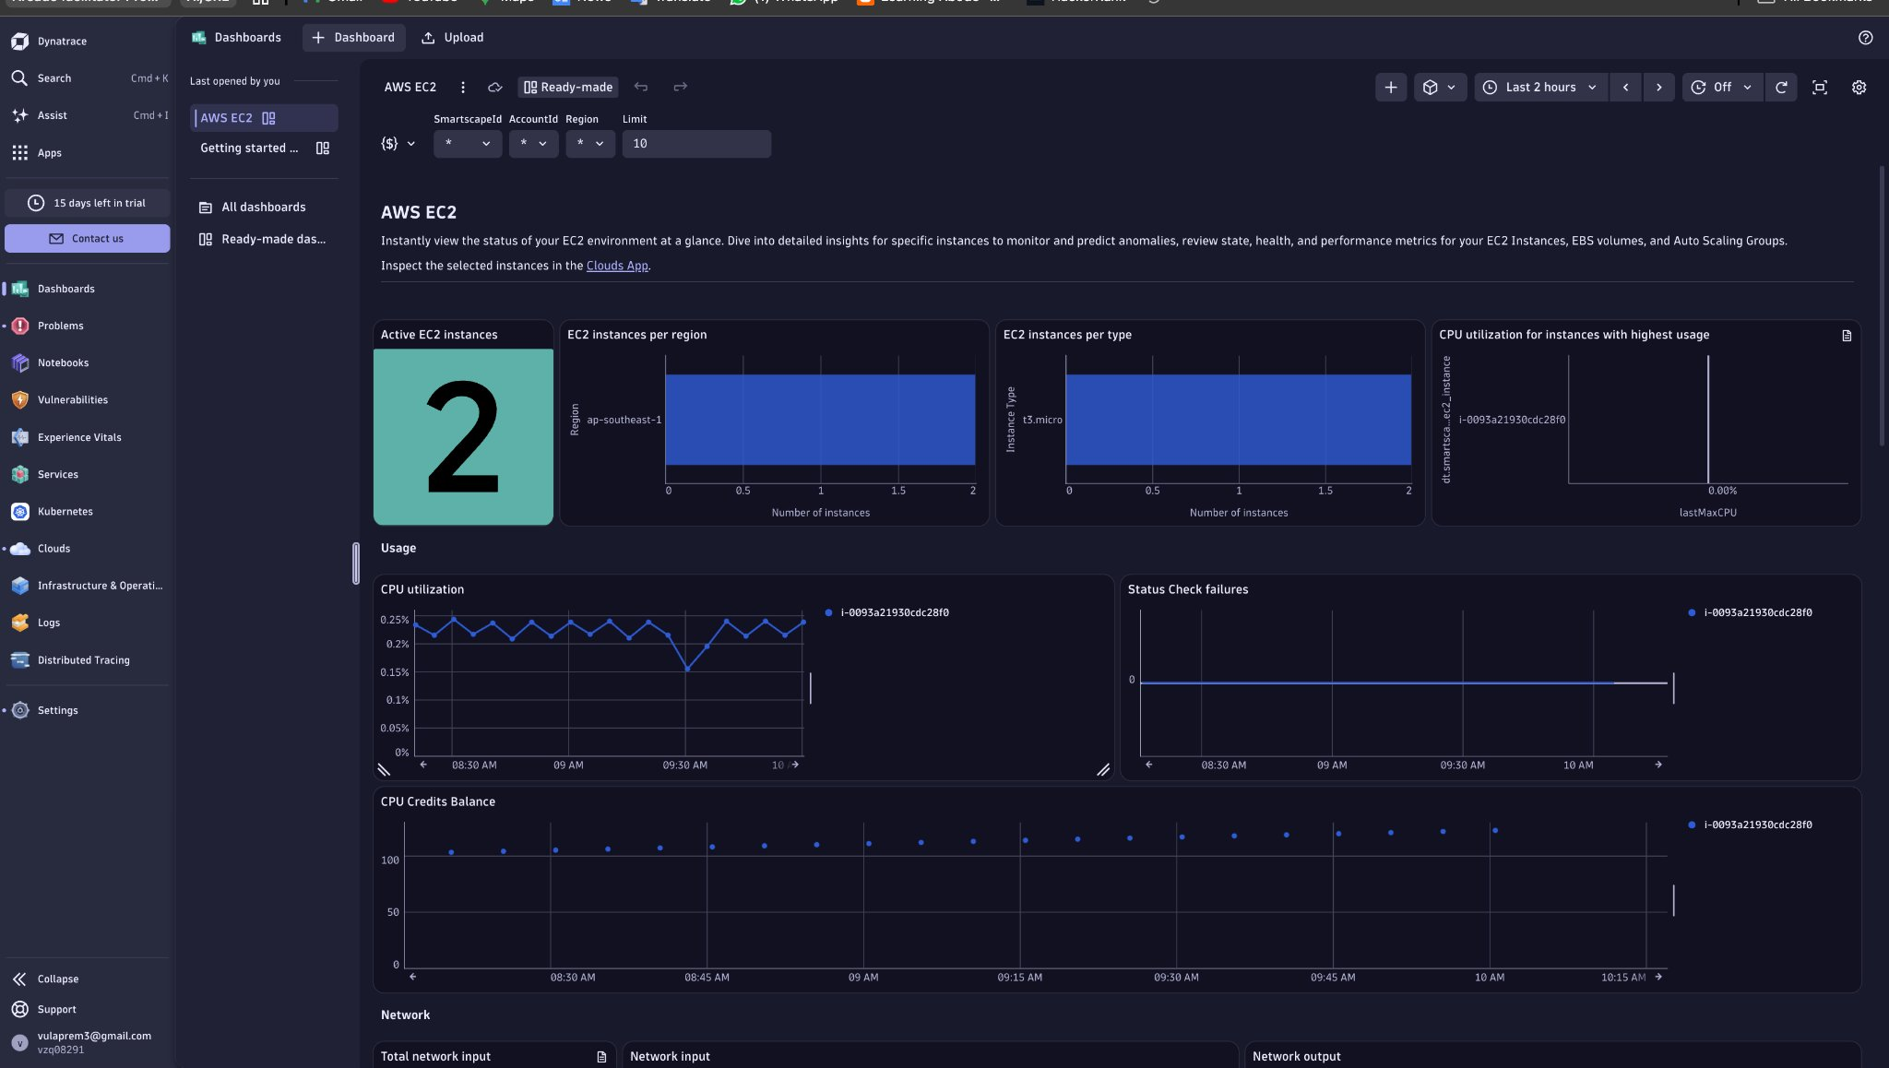
LIVE DEMO
Demo 3 — Infrastructure Monitoring (AWS EC2)
A ready-made AWS EC2 dashboard shows instance count, type, and region at a glance.
CPU utilization and status-check history are tracked per instance, out of the box.
This is pure ‘monitoring’ — healthy numbers here don't guarantee a healthy app.
Next we go one level deeper: the host itself.
Part 6 — Live Demo: Infrastructure (5 min)
Samsung SmartStore · Dynatrace KT

Slide 17
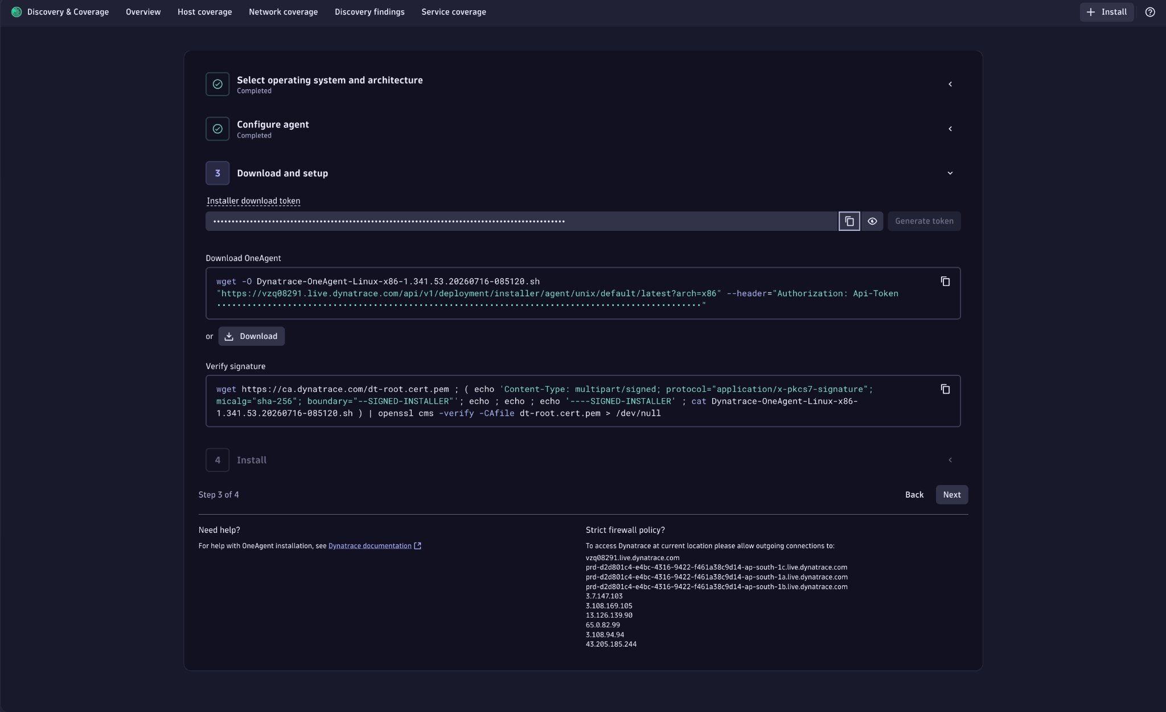
LIVE DEMO
Demo 4 — Host Health Deep Dive
CPU, memory, disk, and network are all visible for the EC2 host running our container.
Availability is tracked continuously — this feeds directly into our uptime SLO.
OneAgent auto-discovers every process on the host without any extra configuration.
This is the same view an SRE opens first when a problem alert fires at 2 AM.
Part 6 — Live Demo: Host Health (5 min)
Samsung SmartStore · Dynatrace KT

Slide 18
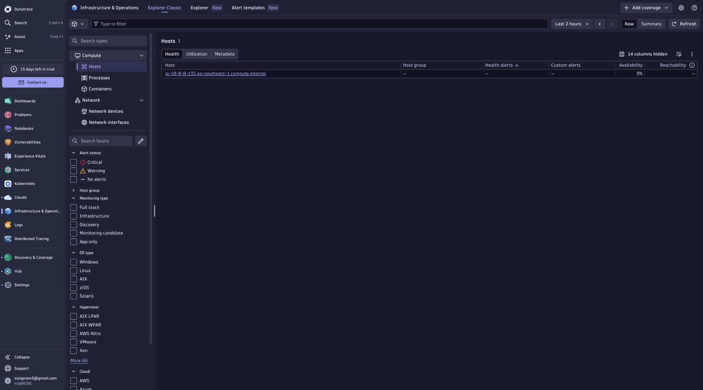
LIVE DEMO
Demo 5 — Process & Container-Level Monitoring
OneAgent breaks CPU and memory down per process — not just per host.
We can see the Samsung SmartStore Docker container running Gunicorn directly.
The health endpoint (/health) confirms the app and database are both reachable.
This granularity is what turns ‘the host is fine’ into ‘this exact process is the problem.’
Part 6 — Live Demo: Processes & Containers (5 min)
Samsung SmartStore · Dynatrace KT

Slide 19
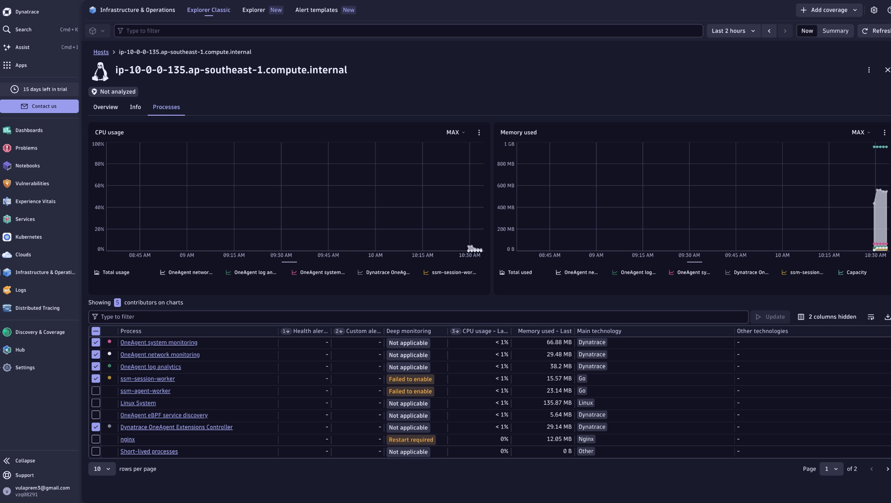
RELIABILITY TARGETS
SLI, SLO, and Error Budget
SLI (Service Level Indicator): the actual measurement — e.g. real response time.
SLO (Service Level Objective): the business target — e.g. 99% of requests under 500ms.
Error Budget: how much failure is allowed before we breach the objective.
Here, Samsung SmartStore's response-time SLO is sitting at 100% status against a 99% target.
Part 7 — SLI / SLO (5 min)
Samsung SmartStore · Dynatrace KT

Slide 20
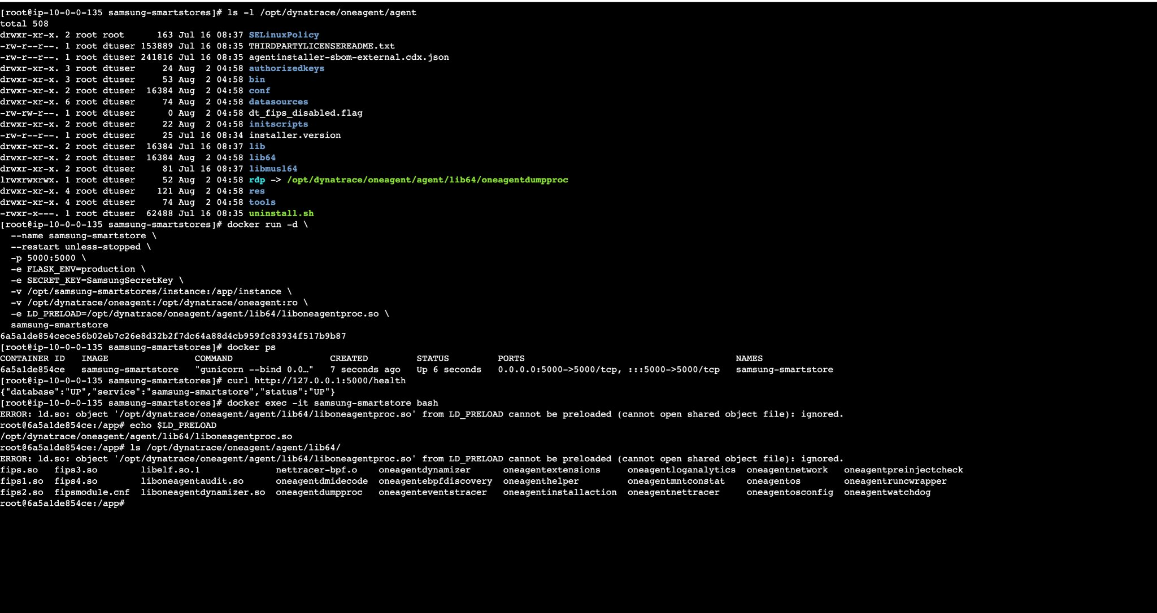
DISTRIBUTED TRACING
Trace Capture & Adaptive Traffic Management
Dynatrace captures a configurable volume of full-stack traces automatically.
Adaptive Traffic Management keeps trace volume within the host's memory budget — important on a t3.micro.
Every captured trace can be replayed request-by-request across services.
This is what lets Davis AI point to the exact slow hop, not just the slow host.
Part 7 — Tracing (part of 5 min)
Samsung SmartStore · Dynatrace KT

Slide 21
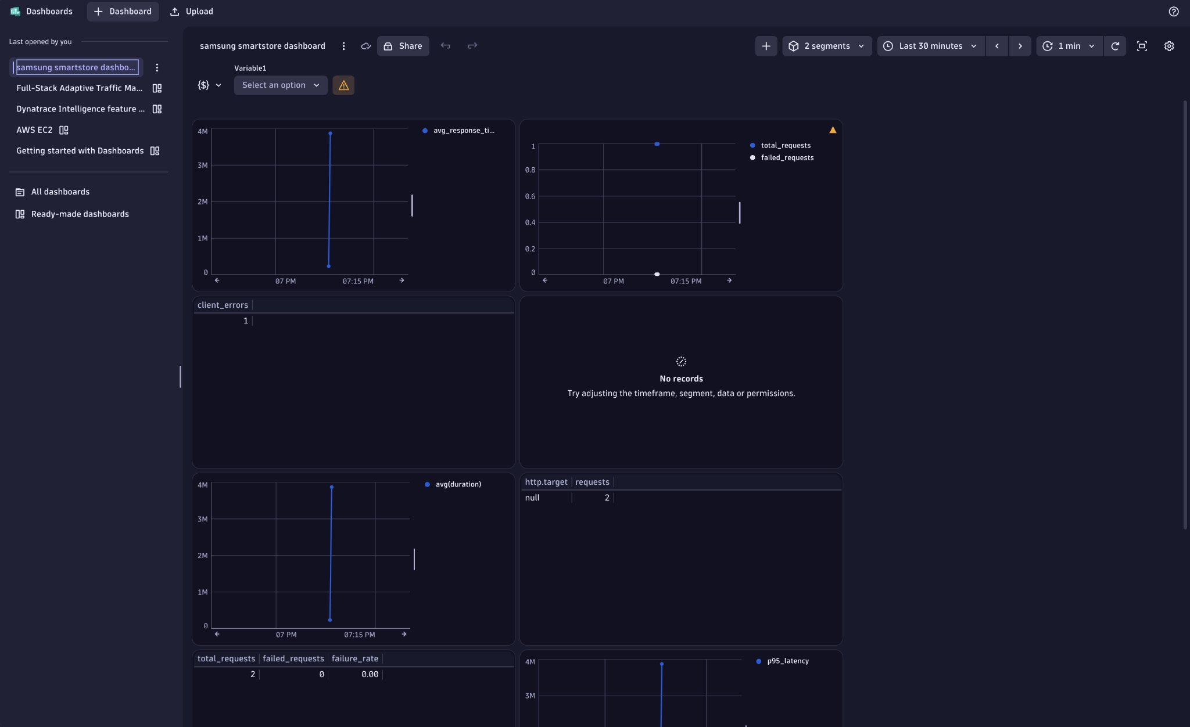
CUSTOM DASHBOARDS
The Samsung SmartStore Dashboard
Purpose-built for this app: average response time, total vs. failed requests, client errors.
Failure rate is computed live as 5xx ÷ total requests — our headline reliability number.
Latency and traffic panels sit side by side so a spike in one is instantly correlated with the other.
This is the dashboard the team actually watches during a release.
Part 8 — Dashboards Deep Dive (10 min)
Samsung SmartStore · Dynatrace KT

Slide 22
ROOT CAUSE ANALYSIS
Davis AI: “Checkout Is Slow”
Users complain
Davis AI doesn't just say ‘CPU is high.’
Dynatrace Problem opened
It tells you:
• Which host
Response time flagged high
• Which process
• Which service
Distributed trace opened
• Which dependency
Database query identified as slow
• The root cause
Root cause found — issue fixed
— instead of leaving you to investigate manually.
Part 9 — Davis AI & Production Example (5 min)
Samsung SmartStore · Dynatrace KT

Slide 23
REAL PRODUCTION SCENARIO
“The Checkout App Is Slow”
1
Symptom
Users report checkout is slow
2
Trace
Frontend → Payment Service → Database
3
Detection
One pod in CrashLoopBackOff; another has high response time
4
Root Cause
Database query delay pinpointed via distributed tracing
5
Outcome
Exact bottleneck found in minutes — MTTR drops sharply
Without Dynatrace: hours of manual log-checking across services. With Dynatrace: minutes, automatically.
Dynatrace KT Session
11

Slide 24
WRAP UP
Key Takeaways
Observability > Monitoring
OneAgent = zero-touch
Metrics + logs + traces together explain WHY, not just WHAT.
One DaemonSet per node auto-discovers everything, no code changes.
ActiveGate secures the path
Davis AI cuts MTTR
Optional but common in locked-down or air-gapped environments.
Automatic root-cause analysis replaces manual log-hunting.
Dynatrace KT Session
13

Slide 25
Questions & Discussion
Thank you for attending the Dynatrace KT session
Dynatrace KT Session
14

